Slide 1
SOEN 384
Management, Measurement and Quality Control http://users.encs.concordia.ca/~s384_2/
Lecture 8
Software Reviews and Inspections

Slide 2
SWEBOK Ch.8 on Quality
“Quality is defined in terms of pertinent attributes of the specific project and any associated product(s), perhaps in both quantitative and qualitative terms. “
  quality characteristics will have been determined in the specification of detailed software requirements
  Thresholds for adherence to quality are set for each indicator
Procedures relating to ongoing SQA throughout the process and for product (deliverable) verification and validation are also specified at this stage
  technical reviews and inspections
soen6841-F15-L8: SQA

Slide 3
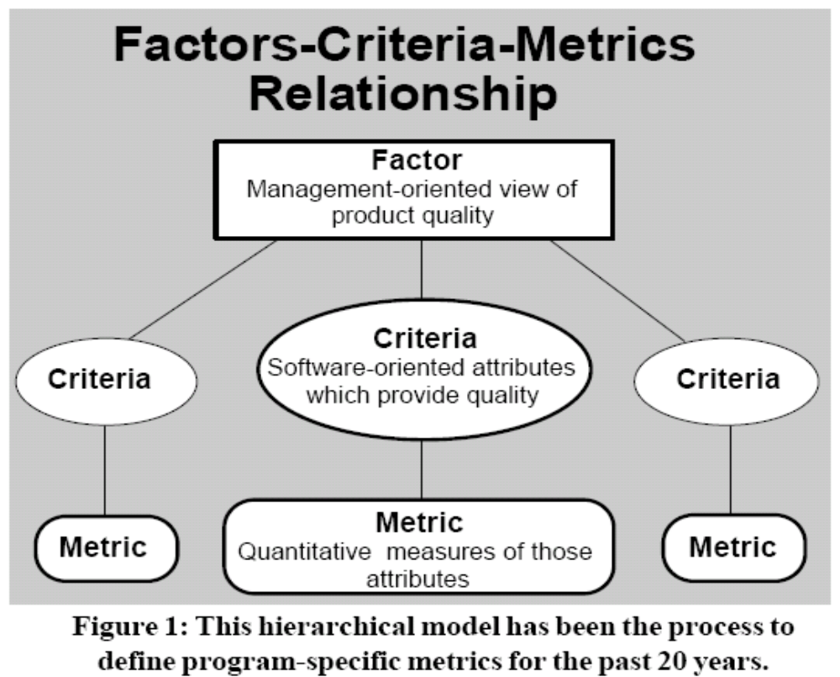
IEEE Std.1061-1998:
Factor – Criteria –Metrics Software Quality Framework
How do we know if we have really measured the attribute we wanted
to measure?
(Criteria)
soen6841-F15-L8: SQA
Notes:
This hierarchical model has been the process to
define program-specific metrics for the past 30 years.
The “factors” at the highest level of the hierarchical model in
Figure 1 define the overall program issues or objectives which will
be addressed by the selected software metrics.
The “criteria” at the next level of the
Factors-Criteria-Metrics model describe
the software product or process characteristics
which are directly linked to the
program issues and objectives. These
characteristics are defined in softwarerelated
terms and represent the critical
software attributes which must be
achieved in the program. The definitions
of software characteristics at this level are
still rather general and are not defined as
specific quantitative values.
The lowest level of the Factors-Criteria-
Metrics model defines the specific
quantitative units to measure the selected
software criteria. These units are directly
linked to the design and physical structure
of the software.

Slide 4
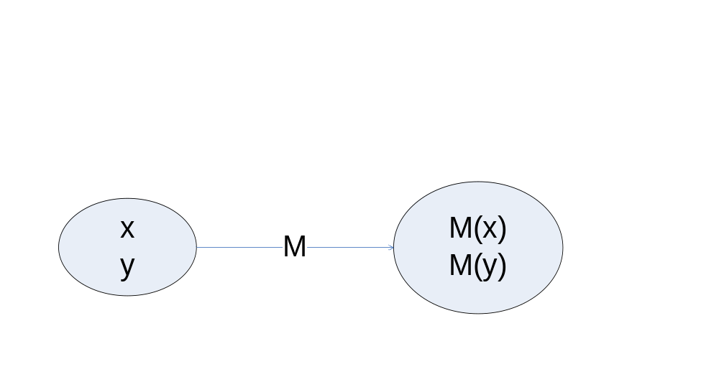

Representational Measurement Theory: Link between Measures & Empiricism
Representational theory of measurement:
  rigorous framework for determining when a proposed measure really does characterize the attribute it is supposed to.
1
2
3
x is taller than y ⬄ M (x) > M (y)
Where M(x) is the height of a person x.
x is taller than y
M (x) > M (y)
soen6841-F15-L8: SQA
Notes:
To answer these questions, we must establish the basics of a theory of
measurement. We begin by examining formal measurement theory, developed
as a classical discipline from the physical sciences. We see how the
concepts of measurement theory apply to software, and we explore several
examples to determine when measurements are meaningful and useful in
decision-making. This theory tells us not only when and how to measure,
but also how to analyze and depict data, and how to tie the results back to
our original questions about software quality and productivity.
This rigorous approach lays the groundwork
for applying measurement concepts to software engineering problems. Our
foundation, introduced in this lecture, supports a scientific and effective
approach to constructing, calculating, and appropriately applying the
metrics that we derive.

Slide 5
Meaningfulness of the analysis of the measurement data and mathematical operations
Measurement data is a collection of numbers.
One can always perform mathematical operations on numbers (add them, average them, take logarithms, etc.)
What kind of mathematical manipulations are meaningful?
  Depends on the scale type of the measure
soen6841-F15-L8: SQA

Slide 6
SWEBOK Ch.8 on Quality
“Quality is defined in terms of pertinent attributes of the specific project and any associated product(s), perhaps in both quantitative and qualitative terms. “
  quality characteristics will have been determined in the specification of detailed software requirements
  Thresholds for adherence to quality are set for each indicator
Procedures relating to ongoing SQA throughout the process and for product (deliverable) verification and validation are also specified at this stage
  technical reviews and inspections
soen6841-F15-L8: SQA

Slide 7
Inspection v.s. Review
A software review is "A process or meeting during which a software product is examined by a project personnel, managers, users, customers, user representatives, or other interested parties for comment or approval".
Inspection is a very formal type of peer review where the reviewers are following a well-defined process to find defects.
soen6841-F15-L8: SQA
Notes:
Software inspections are the most rigorous form of Reviews and fully utilize these elements in detecting defects.

Slide 8
Process for the Review and Revision of Requirements
  Inner consistency checking of all related documents
  Verifying against defined best practices (rules, checklists)
  One efficient way to provide feedback on the author’s work (Inspections and peer reviews)
soen6841-F15-L8: SQA
Notes:
Guidelines:
Spend at least half as much time reviewing as you spend producing it

Slide 9
Inspection as Natural Part of Software Development
Inspect
Document
Requirements
Analysis
most often used
Inspect
Document
Design
Inspect
Code & doc.
Inspect
Test Cases
Code &
Manuals
Functional Test
Inspect
Test Cases
least often used
Component
Test
Inspect
Test Cases
System Test
soen6841-F15-L8: SQA

Slide 10
Inspections v.s. CMM
The Adoption of Inspections by an Organization may depend on its Maturity.
In the Capability Maturity Model (CMM), Inspections belong to CMM Level 3.
soen6841-F15-L8: SQA
Notes:
The Main Concern with Software Inspections is the Cost-Benefit Ratio and Return on Investment (ROI).
To Properly Adopt Software Inspections Practice, Each Participant is Trained in the Structured Review
Process, Defined Roles of Participants, System of
Process and Product Checklists, and Forms and
Reports.

Slide 11
Role of
Inspection and Review
The main objective of an Inspection or a Review is to detect defects.
Inspections and reviews are testing of software artifacts without the actual execution of code and is especially suited for :
  Requirements documents
  Design documents
  Plans and Tests Cases
soen6841-F15-L8: SQA
Notes:
Software Inspections are a Disciplined Engineering Practice introduced at IBM [Fagan, 1976]

Slide 12
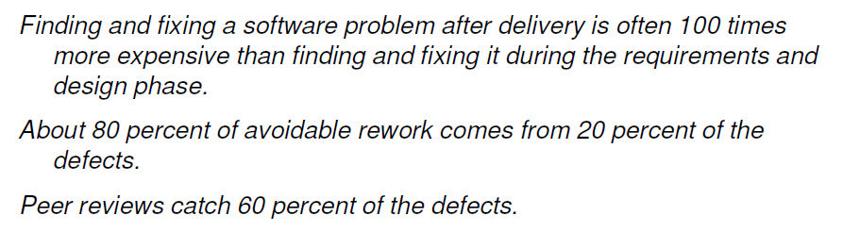
Software Defect Reduction Top 10 list
http://www.sei.cmu.edu/library/abstracts/reports/09sr018.cfm
soen6841-F15-L8: SQA

Slide 13
General comments
Quality management of the specification/design/coding process
  efficiency of removing defects before system testing, time spent on reviews of specification/design/code before testing, management of the defect content.
Simple charts are required to track defects from milestone to milestone.
soen6841-F15-L8: SQA
Notes:
enormous benefits of finding and fixing essentially all of the defects before they start testing.

Slide 14
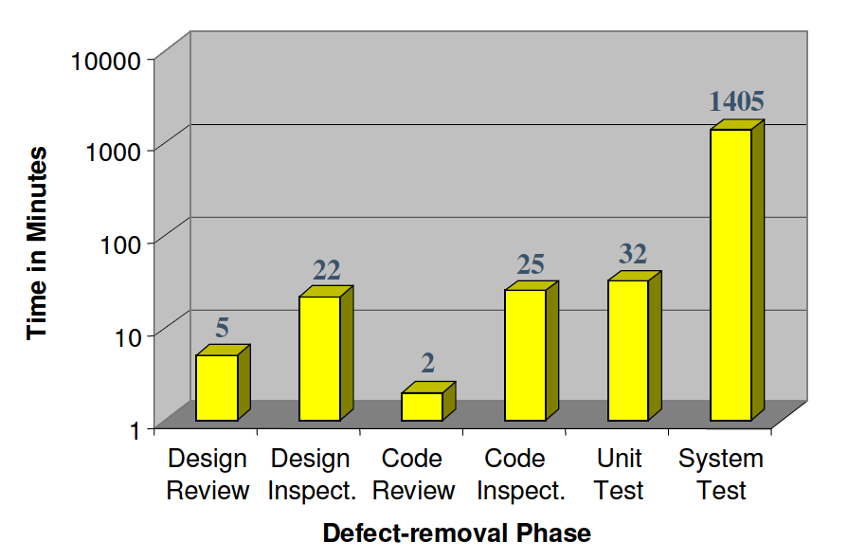
Defects Require Time to Find and Fix
http://www.sei.cmu.edu/library/abstracts/reports/09sr018.cfm
soen6841-F15-L8: SQA
Notes:
Code reviews are fundamentally more efficient than testing for finding
and fixing defects.

Slide 15
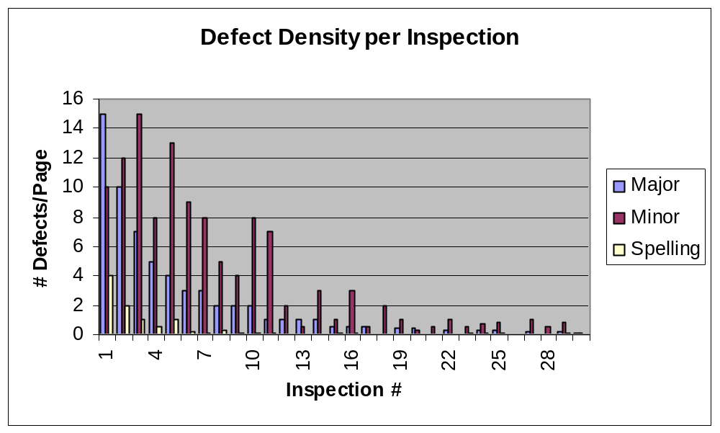
Defect Density to Expect
soen6841-F15-L8: SQA

Slide 16
Motivation for Inspections / Reviews
provide Value in improving specified functional requirements as well as non-functional requirements such as supportability, performance and usability
provide Inner Consistency Checking and Verification Against Defined Best Practices (Rules, Checklists) of Artifacts in Form of Feedback by Peers.
soen6841-F15-L8: SQA

Slide 17
Inspections process
Planning: The inspection is planned by the moderator.
Overview meeting: The author describes the background of the work product.
Preparation: Each inspector examines the work product to identify possible defects.
Inspection meeting: During this meeting the reader reads through the work product, part by part and the inspectors point out the defects for every part.
Rework: The author makes changes to the work product according to the action plans from the inspection meeting.
Follow-up: The changes by the author are checked to make sure everything is correct.
The process is ended by the moderator when it satisfies some predefined exit criteria.
soen6841-F15-L8: SQA
Notes:
Planning, Overview meeting, Preparation, Inspection meeting, Rework and Follow-up. The Preparation, Inspection meeting and Rework stages might be iterated.
Typically Software Inspections Include an
Individual Reading Step:
Several Inspectors Read the Artifacts Alone and
Record the Detected Defects.
2. Individual Reading of Artifacts Strongly Relies
on the Reader's Experience and Concentration.
3. To Improve the Output of the Individual
Reading Step, Checklists and Special Reading
Guidelines are Provided.

Slide 18
Inspecting: The Key Points
2 to 5 inspectors :
  at least 2 different roles
  the author cannot be the inspection leader
  the author can be an inspector with at least 2 other inspectors
Inspect slowly to find more important defects :
  3 to 5 pages/hour for most documents
  up to 20 pages/hour for code (~1,000 LOC)
soen6841-F15-L8: SQA

Slide 19
Inspecting: The Key Points (con’t)
Small chunks :
  10 pages or less (1 page = 300 words)
  Keep inspection time below 2 hrs
Attitude, attitude, attitude!
  Respect
  Professionalism
  Minded to help the author
  Aim for excellence
  Give/share/receive
soen6841-F15-L8: SQA

Slide 20
SRS Review Exercise
(Homework 3)
In class
Form teams of 3-4 students, write down team members’ names
Choose a team leader and write the email address of the team leader
Follow the instructions

Slide 21
Requirements Inspection Rules
(From Sylvie Trudel’s slides)
TESTABLE :
  A requirement shall be testable by any means.
ELEMENTARY :
  Requirements shall be stated at the lowest possible level.
  A requirement shall contain only one testable item. As a guideline, if two or more things have to be tested in order to validate the requirement, then it is not expressed at the elementary level.
NEED :
  A requirement shall be stated in term of final needs, not perceived means (state the « What », not the « How »).
soen6841-F15-L8: SQA

Slide 22
Redaction guidelines for requirements
(From Sylvie Trudel’s slides)
Karl Weigers, Software Requirements, Microsoft Press, 2000
Write short sentences and paragraphs.
Do not write passive sentences.
Write complete sentences with correct grammar and punctuation.
Use consistent terminology that is defined in the glossary.
Always use the same sentence pattern : « The system shall » followed by an active verb and an observable result.
Avoid vague expressions such as « user friendly », « easy », « simple », « fast », « efficient », « superior », « robust », etc.
Avoid comparison verbs such as « optimize », « maximize », « minimize ». Instead, quantify the desired improvement level or specify a lower limit and an upper limit.
Avoid design level details such as “press button”
soen6841-F15-L8: SQA

Slide 23
Defect category to use: ^{Severity}
^{S=typo, syntax or spelling;}
M=minor (incorrect or incomplete but does not limit understanding;
C=Critical/Major (potential defect will induce rework, limit or avoid understanding or functioning as ^{requested/desired).}
soen6841-F15-L8: SQA

Slide 24
Defect category to use:
^{Type}
F = Functional defect
  Defect that may affect functionality
    E.g. missing or unclear functional requirement
N = Non functional defect
  Defect that is not likely to affect functionality
    E.g. inconsistence in document format
U = Undetermined defect category
  Defect for which it is not obvious whether it has an impact or not on functionality
    E.g. a syntax error in a functional requirement
  Should be categorized into F or N by consensus among participants
soen6841-F15-L8: SQA

Slide 25
Homework 3 on SRS reviews: (2%, team work, Deadline: October 7th by midnight )
Goals and guidelines:
  Concentrate on Critical, then Minor defects
  note any defect observed
Team members:
  Read the SRS document
  Annotate all defects by Severity and Type
  Fill in Potential defect list
  Submit your defect list to the team leader
soen6841-F15-L8: SQA

Slide 26
Homework 3 on SRS reviews/inspections: Deliverable
(2%, team work, Deadline: October 7th by midnight )
Team leader:
  Collect and merge team members’ defect lists
  Complete an inspection form for the team
    List the names and IDs of the team members on the team submissions
  Submit electronically (EAS) as proposal 3 a zipped file with all individual team members’ lists of potential defects, a form will all potential defects discovered by the team, and the team inspection form.
  Mark: % of defects found by the team

Slide 27
ToDo:
Practice SRS reviews/inspections on the SRS exercise (Homework 3)
soen6841-F15-L8: SQA

Slide 28
Next?
Review of Software Engineering Measurement. Exercises
soen6841-F15-L8: SQA

